Slide 1
Notes:
Cover – title slide
We would like to present you the ECIU University Initiative and our vision for the year 2030.

Slide 2
PART 1
ECIU SINCE 1997
ECIU UNIVERSITY
PART 2
VISION 2030
PART 3
Notes:
This presentation has 3 main parts:
ECIU – the brief introduction to the European Consortium of Innovative Universities.
Second part will focus on the ECIU University.
We will also present our vision towards 2030 – the mission and the key elements for the future of European University.
Presentation structure and introduction

Slide 3

PART 1:
ECIU SINCE 1997
Notes:
Let’s start with the ECIU - the European Consortium of Innovative Universities.
The initial spark for forming ECIU was a study in 1996 by Burton Clark about entrepreneurial universities.
In 1997, some of the Universities as examples he mentioned in his study, came together in Twente to form the ECIU. The aim was to share experience and best practices, to be stronger and have a voice with a bigger impact than as the individual institution.

Slide 4
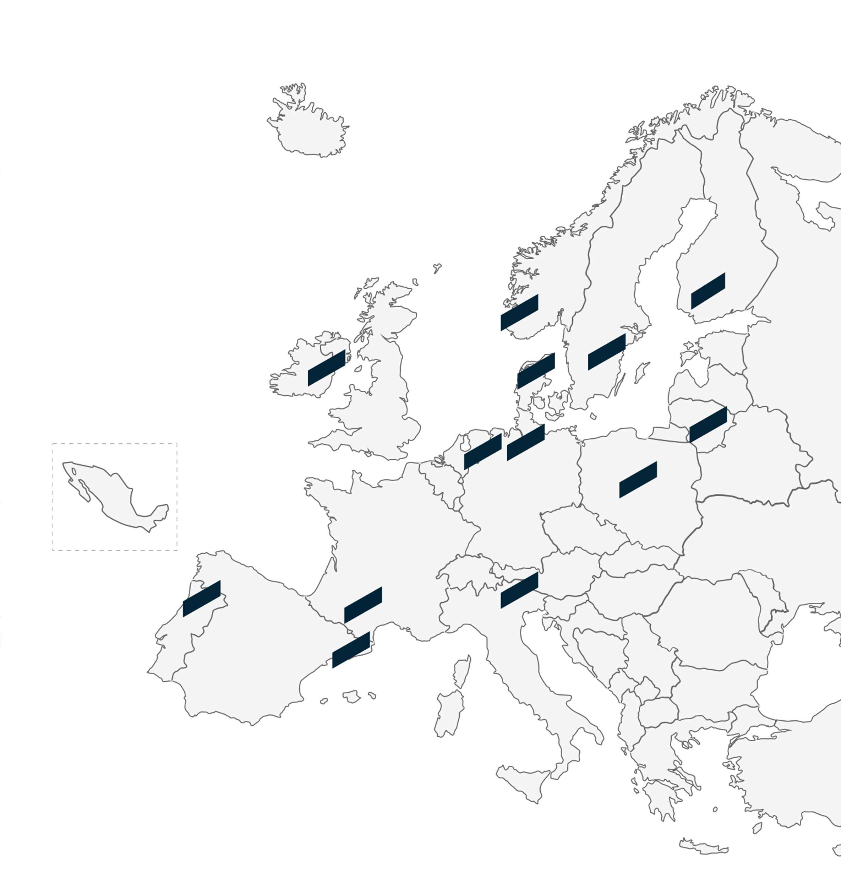













Notes:
ECIU is a small but active network of 13 like-minded universities across Europe and one member in Mexico.
What is this ECIU shared profile that is very important to us?
- research intensive universities with particular strengths in combining engineering with social sciences
- all member universities are relatively young and share entrepreneurial values: innovation and entrepreneurship in the DNA of all institutions
- are committed to sharing new forms of teaching and learning
- wish to sustain and nurture internally minded staff;
- all universities are key players in the regional innovation systems; All were founded in regions where major industries had declined and therefore made a significant contribution to the regeneration of the regions. Common challenge: How to attract international talents to our regions.

Slide 5
ECIU Network
Uniting Over
ECIU
Members
298,000
STUDENTS
University of Twente (The Netherlands)
Aalborg University (Denmark)
Dublin City University (Ireland)
Hamburg University of Technology (Germany)
46,688
STAFF incl. 27,182 Academic Staff/Researchers
Kaunas University of Technology (Lithuania)
Linköping University (Sweden)
Tampere University (Finland)
489
RESEARCH GROUPS
Universitat Autònoma de Barcelona (Spain)
University of Aveiro (Portugal)
University of Stavanger (Norway)
University of Trento (Italy)
147
FACILITIES
Institut National des Sciences Appliquėes (France)
Lodz University of Technology (Poland)
TEC de Monterrey (Mexico)
Notes:
ECIU has one partner per member country.
Tecnológico de Monterrey in Mexico as a non-European partner because they fit the ECIU profile so well.
Together we unite nearly 300 thousand students, nearly 50 thousand staff members, including academic staff and researchers. Together we also have 147 faculties and nearly 500 research groups.
The members are [name the list].

Slide 6

PART 2:
ECIU UNIVERSITY

Slide 7







NEED FOR SYSTEMIC CHANGE
Climate Change
The Sustainable Development Goals
Societal Impact
Standard Degree is not enough
Learners Demand for truly international and interdisciplinary education
Skills gap
Learners need On-Demand Access to specific/ad-hoc learning
Notes:
In 2017, the Rectors and Presidents of the ECIU universities started the discussion on the future of the universities in Europe. The role of universities in Europe is changing rapidly. As innovative universities, we can’t stand still. We need a systemic change in higher education.
Why? ​
Climate change requires a new type of multi-disciplinary approach in research and extensive collaboration with the world outside academia. ​
Similarly, the pressing challenges of the Sustainable Development Goals drive universities to reconsider their traditional ways of thinking and working. ​
At the same time, the need to create societal impact in the way we teach, do research and innovation. ​
Automation and increased complexity change the demands of the labour market rapidly. New jobs will require more sophisticated skills and competences. The already existing skills gap asks for ongoing digitisation and a stronger role of higher education.
A standard degree is no longer enough or even required for future jobs. ​
Learners’ demand for truly international and interdisciplinary education instead of national and disciplinary education. ​
The learner of tomorrow will grow up in a world where every product can increasingly be tailor-made and is available in a flexible way (time and place). Hence, our future learners expect to be able to acquire on-demand access to knowledge and skills in the same way. ​
On top of this, Corona has reshaped the way global higher education is delivered. 2020 has been a true catalyst for change, urging universities more than ever to reconsider their role in society. ​
In the ECIU network, we have been co-creating with our learners, staff, and partners from business and society a new innovative model of education, research and, innovation. ​
Source: OECD 2018

Slide 8

Notes:
The need for systematic change was the main driver for the ECIU to establish the ECIU University - the European university where learners, teachers, and researchers cooperate with cities and businesses to solve real-life challenges.
A short story in the video:
https://vimeo.com/eciuuniversity/download/321068392/ab0727615c

Slide 9
ECIU UNIVERSITY: WHY ON A EUROPEAN SCALE?
Long-term strategic collaboration
For the European job market
with industry and society.
ECIU University provides necessary job skills.
Broad portfolio of the best education
European-wide recognition
from the European partners and their stakeholders based on the SDGs.
of the educational model based on skills and competences.
ECIU University connects
Scalability
Cultures, enables people to move freely.
to make a real systemic change in Higher Education for the benefit of society.
Notes:
ECIU University is more than just online education: it is based on real-life challenges, micro-modules, and virtual collaboration on SDG 11.
For this, the ECIU University relies on the interaction between the European-wide virtual ECIU University organisation, the physical ECIU member university campuses, and the involvement of our stakeholders.
Why are we doing this on a European scale?
Long-term strategic collaboration with industry and society in education on a European scale to maximize impact.
A broad portfolio of the best education from the European partners and their stakeholders based on the SDGs.
ECIU University connects cultures, enables people to move freely (virtually and physically) between the universities and their stakeholders.
For the European job market
ECIU University provides necessary skills well
aligned with the needs of society.
A European-wide recognition
of the educational model based on skills and competences (and not on degrees).
Scalability
to make a real systemic change in Higher Education for the benefit of society.

Slide 10
SUPPORT OF OUR BUSINESS STAKEHOLDERS
AIRBUS
PONSSE
Aerospace Sector, Germany
Production and sales of forest machines, Finland
CISCO
SUEZ ENVIRONMENT
Networking hardware and software, The Netherlands
Water and waste sector, Spain
SANDOZ INDUSTRIAL PRODUCTS
NXP
S.p.A – Gruppo Novartis, healthcare company, Italy
Semiconductors, Germany
INTEL
ENGINEERING INGEGNERIA INFORMATICA SpA
Technology, Ireland
Information, Technology sector, Italy
ERICSSON AB
IGNITIS GROUP
Technology and service provider to telecom operators, Sweden
Energy Company, Lithuania
HELLA
SICK AG
Automotive supplier, Lithuania
Sensor Intelligence, Germany
LYSE GROUP
Energy and telecommunication, Norway
Notes:
The ECIU University concept was co-created with many stakeholders.
From the very start we were supported by business and social stakeholders, companies like Airbus, Cisco, Sandoz, Intel, Ericsson, to name a few.

Slide 11












SUPPORT OF OUR PUBLIC STAKEHOLDERS
ITALY
FINLAND
Autonomous Province of Trento
Municipality of Trento
Confindustria Trento, Employers’ Association
Hub Innovazione Trentino, Regional Innovation and Technology Transfer Agency
City of Tampere
Tampere Region
DENMARK
SPAIN
Danish Minister of Higher Education
Barcelona City Council
Cerdanyola del Vallès City
PIMEC 2030, Public stakeholder, SME and craft association
IRELAND
Fingal County Council
France
Occitanie Europe
PORTUGAL
NETHERLANDS
Inter-Municipal Community of the Region of Aveiro (CIRA)
City of Enschede
Oost NL , Regional Development Agency
LITHUANIA
GERMANY
Kaunas Region
Kaunas District Municipality
City of Hamburg
NORWAY
SWEDEN
City of Stavanger
Region Östergötland
Notes:
The support of our social stakeholders – city and region municipalities, employers’ associations, innovation hubs, and technology transfer agencies is proof of our strong link to our surrounding regions, and the need to connect societal stakeholders across Europe.

Slide 12


WHAT ARE THE EUROPEAN
UNIVERSITIES?
“CHALLENGE BASED” UNIVERSITIES
ACTING AS ROLE MODELS
17 European University Alliances started in 2019
They received 5 Million per network for three years (plus national co-financing)
2021: second call, resulting in over 280 higher education institutions, forming 41 alliances
H2020 SWAFS call, 2 million per alliance from DG Research and Innovation to strengthen the research pillar.
TRANSNATIONAL KNOWLEDGE CREATING TEAMS OF
STUDENTS / TEACHERS
/RESEARCHERS ADDRESSING SOCIETAL CHALLENGES
Notes:
In his Sorbonne speech in September 2017, Emmanuel Macron came up with the idea to create 20 European Universities by 2024. This was followed by a call of the Directorate of Education and Culture.
ECIU, together with all partners, submitted the proposal of the ECIU University to the pilot call.
In June 2019, results were announced and ECIU was one of the 17 pilot alliances. The second call for the European Universities in 2021 resulted in over 280 higher education institutions forming 41 alliances.
In addition to this, H2020 SWAFS call in 2021, ensured 2 Million per alliance from DG Research and Innovation to strengthen the research pillar of the European Universities.
HOW WILL EUROPEAN UNIVERSITIES LOOK LIKE IN 2025-2030?
Imagine:
- Design your own curriculum across disciplines, borders, cultures, and languages
- Build the specific skills you need for your future
- Learners, teachers, researchers, companies, and cities working together to tackle society’s greatest challenges
- Transforming higher education in Europe
- European Universities are the universities of the future

Slide 13

European Universities will equip their students, staff, and researchers with the skills they need to navigate the twin green and digital transition of our society.
They are a key building block not only for the European Education Area, but also for the future of Europe.
MARIYA GABRIEL
COMMISSIONER
Notes:
The European Universities is a very important initiative at the European level.
We can quote Mariya Gabriel, EU Commissioner for Innovation, Research, Culture, Education and Youth: [quote text]

Slide 14

PART 3:
VISION 2030
Notes:
The ECIU University Board agreed on the long-term vision of the ECIU University. The vision describes how ECIU University will pioneer as a challenge-based university at the European level. The important note is that the university is based on the needs of society, it solves challenges and reskills the workforce to ensure significant societal impact.
The vision for 2030 underlines that the ambitions stretch much further than only the project. We have committed ourselves to a joint process towards impactful innovative education and research at the European level.

Slide 15

ECIU UNIVERSITY
MISSION
ECIU University is an agile, open agora at the European level for solving multi-disciplinary societal challenges, doing research and learning for life.
We create an invigorating model of a true European University for the benefit of European society.
Notes:
What is the ECIU University mission?
ECIU University is an agile, open agora at the European level for solving multi-disciplinary societal challenges, doing research, and learning for life.
We create an​ invigorating model of a true European University for the​ benefit of European society.​

Slide 16
ECIU UNIVERSITY
VISION
European wide ecosystem based upon open
and inclusive collaboration connecting societal
stakeholders, researchers and learners
Playground for solving multi-disciplinary
challenges in entrepreneurial, innovative ways
Personalised learning and career opportunities
University model based upon co-creation
Notes:
What is the ECIU University vision?
We believe in a European-wide ecosystem based upon open and inclusive collaboration connecting societal stakeholders, researchers, and learners to provide European answers to future societal challenges.
We create a playground for solving multi-disciplinary challenges in entrepreneurial, innovative ways.
We provide personalised learning and career opportunities for life at the European level.
We enable a novel university model based upon co-creation.

Slide 17

OUR VALUES
Academic quality
Entrepreneurial mind-set
Open ecosystem
Agility and flexibility
Personalised, inclusive community
Impact on society
Resilience into the future
Notes:
Research, education, and innovation in ECIU University reflect our values:
Academic quality
Entrepreneurial mind-set
Open ecosystem
Agility and flexibility
Personalised, inclusive community
Impact on society
Resilience into the future

Slide 18
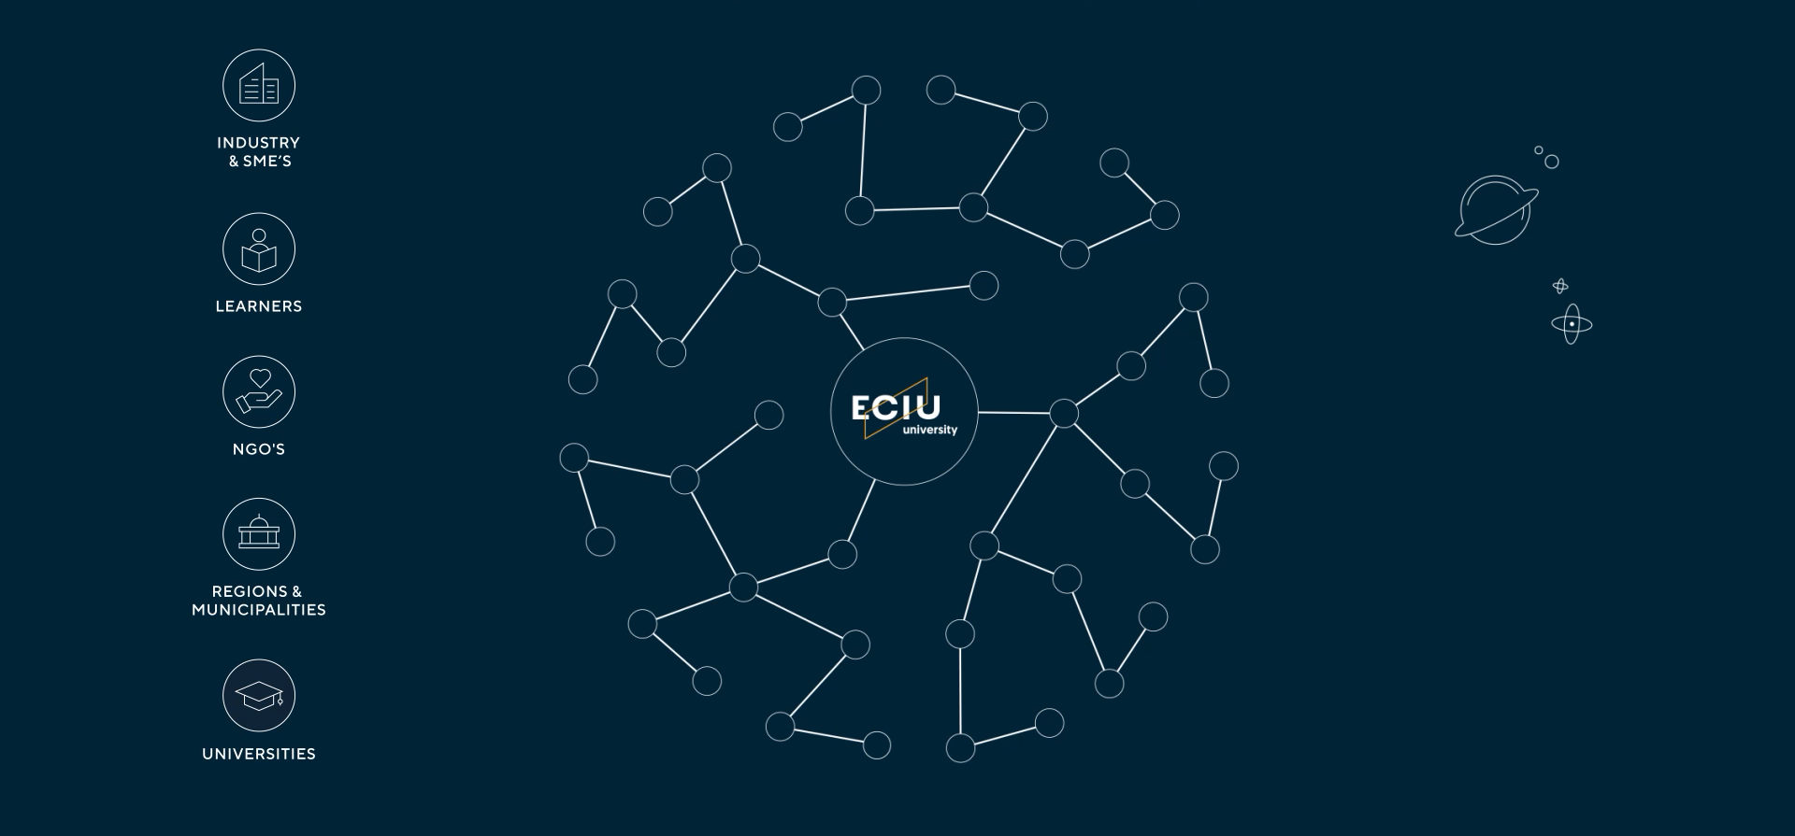
ECOSYSTEM (AGORA)
Notes:
The ECIU University is an ecosystem.
ECIU University is about co-creation. We work and create value empowering our learners and partnerships.
We nourish our people to step in and stand up for the benefit of the community and society, at the same time co-creating value for themselves.
Our model encourages active membership in the community, as the costs of participation in ECIU University depend on the input and value the individual creates for the community and society.

Slide 19

KEY ELEMENTS OF ECIU UNIVERSITY
OPEN COMMUNITY
CUTTING-EDGE TECHNOLOGIES
INNOVATIVE CO-CREATION MODEL
EUROPEAN EDUCATION AND RESEARCH
Notes:
These are the key elements for ECIU University in the vision for 2030
Open community: In 2030, ECIU University is an agile, need-driven agora; European ecosystem where demand and supply of education, research, and innovation of the member universities and their stakeholders come together contributing to Europe and its regions. ECIU University is a space where communities of practice flourish around urgent and relevant societal topics. ​
​
Cutting-edge technologies: Digital transformation is at the core of ECIU University. In 2030, ECIU University functions as a hybrid, digitally-enabled learning, innovation, and knowledge space. We apply cutting-edge technologies broadly, such as Artificial Intelligence (AI) and Big Data, and test new concepts. Stakeholders, researchers, and learners throughout Europe and beyond can use this environment to connect and join our vibrant community no matter where they are. ​
​
Innovative co-creation model: In 2030, ECIU University adopts a novel, resilient funding model based on three underlying factors: (1) full utilisation of data and digitalisation, (2) a functioning European ecosystem with memberships, and (3) the strategy based on demand and supply. ECIU University is about co-creation. We nourish our people to step in and stand up for the benefit of the community and society. Our model is an inclusive community based on efforts – the more one gives, the more one gets. ​
​
European education and research: ECIU University is the innovative testbed of a combined European Education and Research Area. In 2030, ECIU University is a space of the vast individual, research-based learning opportunities for life, provided by ECIU University and its stakeholders. Upskilling and reskilling through micro-credentials help learners to stay intellectually fit and up to date. ECIU Virtual Research Institute is a breeding ground for citizen science with long-term strategic collaborations with societal and industrial partners and citizens. ​
​

Slide 20
Individualized Life-Long Learning Pathways with
Challenges and Micro-modules
1
Real-life challenges come from industry, society and university on SDGs
2
Teams of diverse learners and researchers are formed
3
AI assigns micro-modules to the challenges for skills and competence development
4
Gained skills and competences are stored in a digital competence passport
5
Micro-credentials accumulate into competence passport (or in a degree)
Notes:
How will this learning pathway in the ECIU University will look like?
Foremost, it is the individual life-long learning pathway based on the challenge-based learning pedagogy. Working on challenges and micro-modules are in the core. ​
Step 1: Real-life challenges are provided by industry, society and university on SDGs.
Step 2: Teams of diverse learners and researchers are formed based upon their capability and motivation to work on the challenges.
Step 3: AI aassigns Micro-modules to the challenges for skills and competence development.
Step 4: Gained Skills and Competences are stored in a digital competence passport.
Step 5: Micro-credentials accumulate into competence passport (or in a degree).

Slide 21


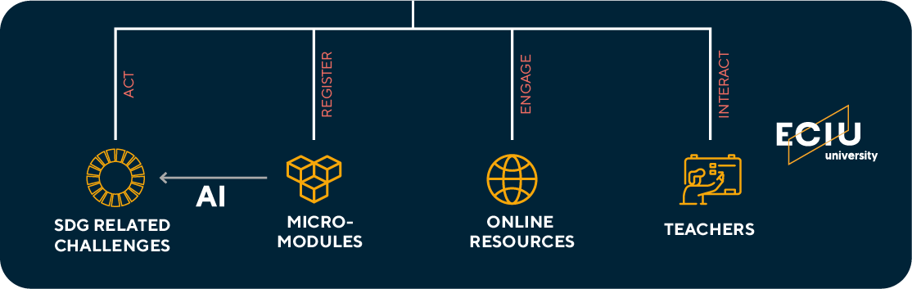

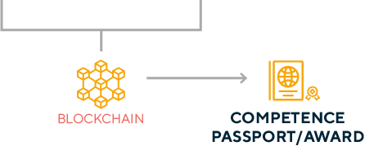
EDUCATIONAL ARCHITECTURE FOR INDIVIDUAL LEARNING
Notes:
The ECIU University Educational Architecture for individualised learning might look like this:
The learner is in the center of this. The motivation to make the world a better place counts. ​
The educational pathway of the ECIU University is flexible in content, duration, and location to include all types of learners. ​We consciously use the term “learners” as meaning to encompass people of any age or background that get access to the ECIU University’s educational pathway. ​
Our educational pathway is all about skills and competences, and not primarily on degrees. ​
The learners will be supported by teamchers (teachers+coach). ​
Artificial Intelligence will be used to compare the current skills profile of an individual to future forecasts on skills and competence needs. Also taking into account the motivation and career plans of the learner.​
During life-time, the learners will return to the ECIU University, to update their skills and competences. Studying at the ECIU University should be an integrated part of professional life. ​

Slide 22




KEY ELEMENTS OF THE EDUCATIONAL PATHWAY
Stackable, credit-bearing and quality assured micro-credentials
Platform solutions for the storage,
sharing and portability of micro-credentials
An open co-creation model and
challenge-based learning approach
Skills and competence recognition

Slide 23

MICRO-CREDENTIALS
A micro-credential is a proof of the learning outcomes (skills and competence recognition) that a learner has acquired following a short learning experience. These learning outcomes have been assessed against transparent standards.
Notes:
Definition:
A micro-credential is a proof of the learning outcomes (skills and competence recognition) that a learner has acquired following a short learning experience. These learning outcomes have been assessed against transparent standards.
Why micro-credentials?
1.To align learning with needs from society
2.To realise flexible, personalised learning paths
3.To enable skills and competence development

Slide 24
KEY ACTIONS
MICRO-CREDENTIALS
01
IT strategy for the ECIU University
02
Define and operationalise three distinctive types of micro-credentials.
03
Alignment with European Standards and Guidelines.
04
Processes for the formal recognition and development of micro-credentials
05
A framework of a unique suite of micro-credentials for the recognition of 21st Century Skills
Many more actions can be found in the ECIU University micro-credentials Whitepaper
Download here
Notes:
ECIU University recognises that platforms are evolving at a rapid pace which requires a dynamic iterative approach as we pilot, respond to and seek to influence the future development roadmap. Therefore, throughout 2021 we will develop an IT-strategy on how to support ECIU University with the use of cutting-edge and fit-for-purpose digital tools. ​
In 2021, ECIU University is consulting with both internal and external partners to establish how we will define and operationalise three distinctive types of micro-credentials: ​
Formal learning as part of regular learning paths​
Formal learning outside of regular learning paths​
Non-formal learning as part of other activities, including short courses, work-related experiences and training offered by industry, and societal partners. ​
In 2021, ECIU University will explore the alignment of micro-credentials with European Standards and Guidelines, and actively contribute to setting European standards as they emerge, to ensure that these standards can be applied at scale, creating an agile and truly European ecosystem. ​
In 2021, ECIU University will engage in a process of consultation with key staff involved in regulatory approval of academic qualifications in each partner institution to better understand and support internal approval processes for the formal recognition and development of micro-credentials and to scale this to the European level in an agile way. ​
In 2021, ECIU University will adopt a framework and explore the development of a unique suite of micro-credentials for the recognition of 21st Century Skills. The initiative will integrate formal, informal, and non-formal learning experiences through a professional learning portfolio to assess skill development against transparent standards. ​
Many more actions can be found in the ECIU University micro-credentials White Paper – please check the ECIU.org

Slide 25
NINE NEEDS FOR THE SUCCESSFUL UPTAKE OF MICRO-CREDENTIALS
01
Living common language
02
Commitment to rigorous academic standards
03
Stronger focus on demand driven and co-constructed micro-credentials
04
Comprehensive programme of professional development
05
Targeted funding round to foster innovation
06
Significant investment in institutional taught leadership
07
Serious commitment to collaboration
08
Stronger community of European developers
09
Greater investment and commitment to research
Notes:
NINE NEEDS FOR THE SUCCESSFUL UPTAKE OF MICRO-CREDENTIALS
1. A living common language: Most EU states have government agency representation as part of the MICROBOL project where the goal is to align micro-credentials with the Bologna process. The risk is that these Government agencies will adopt a conservative and "command and control" mindset that might kill any disruptive or innovative dimension to micro-credentials. The National Universities Associations could be a powerful ally to cultrate, and use to obtain national funding for all universities, although single institutions might risk losing first-mover advantage via this strategy. ​
2. A commitment to rigorous academic standards - The MICROBOL project is working on these standards and most national agencies are partners or associate partners in this dialogue. ​
3. A stronger focus on demand-driven and co-constructed micro-credentials - Right now the world of Higher Education and the world of Industry are largely on separate tracks when it comes to micro-credential and badge development. There are actually very few examples of genuine co-construction of micro-credentials and most of the ones are arising from the MOOC platforms as a broker. See for example what FutureLearn is offering where universities have partnered with AWS, Cisco, Salesforce, Tableau, etc. In our experience, it's easier to do this with a platform outside of the internal IT ecology as there is far more flexibility.​
4. A comprehensive programme of professional development
5. A targeted funding round to foster innovation - both at the national and EU level. Nationally, because collectively the universities have greater weight to stand up to government agencies and we all operate under the same National Qualifications Framework. At the EU level, the funding helps us to put pressure on our national regulations and frameworks and push and stress tests what's possible under the current rules. So there is a push and a pull dimension to this funding. On the one hand, collaboration is also good to benchmark with others but this can also be counter-productive to actually serving the needs and requirements of your own institution.​
6. A significant investment in institutional taught leadership
7. A serious commitment to collaboration
8. A stronger community of European developers - There are a lot of players in the platform space and a number of snake oil merchants trying to sell their next big thing. A stronger community owned and driven more by educators and HEIs might be helpful in this regard. Ultimately the people making the decisions who sit on budgets need to be engaged in at the very least some of the conversations arising out of such a network of interest. ​
9. A greater investment and commitment to research
​
WHAT's NEXT?​
1.We have to be flexible, as new possibilities will emerge​
2.We must address the quality assurance and recognition of short learning courses leading to micro-credentials​
3.We need pan-European, interoperable platforms to enable easy storage, sharing and portability of micro-credentials​
​
More information: ​
-ECIU paper: https://www.eciu.org/news/paving-the-road-for-the-micro-credentials-movement​
-MICROBOL: https://eua.eu/101-projects/782-microbol.html ​
-Future Learn: https://www.futurelearn.com/programs​
​

Slide 26
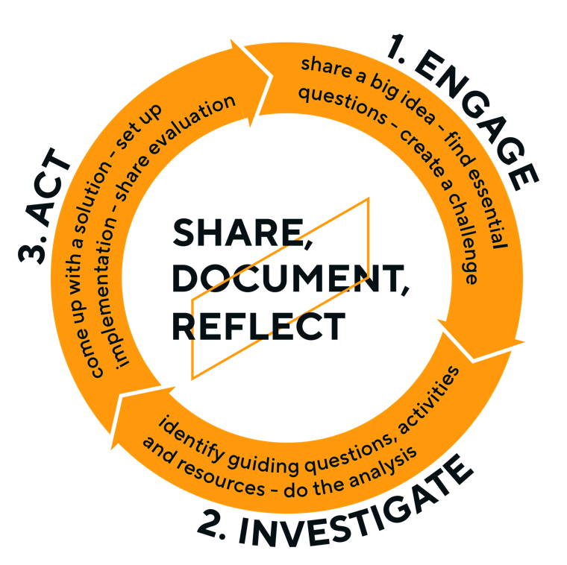
CHALLENGE BASED
LEARNING (CBL)
A pedagogical approach that actively engages students in a situation that is real, relevant and related to their environment.
It takes place through the identification, analysis and design of a solution.
The learning experience is typically:
Multidisciplinary
Involves different stakeholder perspectives
Aims to find a collaboratively developed solutions
Notes:
The challenge-based approach is at the core of the ECIU University
It is a pedagogical approach that actively engages students in a situation that is real, relevant and related to their environment.
It takes place through the identification, analysis and design of a solution to a sociotechnical problem.
The learning experience is typically multidisciplinary, involves different stakeholder perspectives, and aims to find a collaboratively developed solution, which is environmentally, socially and economically sustainable.

Slide 27
Learners
Take Ownership
Teacher as a
Guide and Facilitator
define their own challenges
take over responsibility for team composition
acquire the necessary knowledge and skills to solve this challenge
promoting team culture
being challenging
help students to manage the tasks
enable students to move towards innovative thinking
Notes:
In CBL, learners take ownership of their challenge:
define their own challenges (the problems they want to work on)
take over responsibility for team composition
acquire the necessary knowledge and skills to solve this challenge
The teacher’s role is to be a guide and facilitator:
promoting team culture and being challenging
help students to manage the tasks and show process
enable students to move towards innovative thinking

Slide 28

Notes:
The first three-year phase of the ECIU University focuses on the UN Sustainable Development Goal 11 "Sustainable cities and communities”.

Slide 29
LONG-TERM RESEARCH STRATEGY
Energy and Sustainability
Circular Economy
‍The ECIU University joint long-term research strategy on smart regions. Initial focus on:
Transport and Mobility
Resilient Communities
Notes:
The ECIU University has developed a joint long-term research strategy on smart regions, building on the rapid development of digital infrastructures across Europe to address common research challenges related to SDG 11 (Sustainable Cities and Communities) topics.
Our distinct Challenge Based Research themes that the ECIU University will initially focus on are:
● Energy and sustainability
● Circular economy
● Transport and mobility
● Resilient communities
Two cross-cutting themes that underpin the ECIU University approach to addressing these challenges are:
● Human capital development
● Co-creation, including interdisciplinarity
See full strategy: https://media.dcu.ie/media/ECIUfullreport/

Slide 30

SMARTER-ER
The ECIU University Research Institute for Smart European Regions:
new model of barrier-free research and innovation, based on a virtual collaborative environment;
framework for joint research that value-capture and deliver solutions to current and future UN SDG challenges;
science - society cooperation and citizen research initiatives in practice, to help overcome the limitations of disciplines, sectors and countries.
‍The SMART-ER project is implemented under the EU Research and Innovation programme Horizon 2020 part “Science with and for Society (SwafS)
Notes:
The ECIU University Research Institute for Smart European Regions – the SMART-ER:
new model of barrier-free research and innovation, based on a virtual collaborative environment. SMARTER activities will be implemented by bringing together scientific and management research capacities at the 12 ECIU University member institutions. Jointly, the institutions will pilot capacity building programmes (Seed Programme and SMART-ER Academy) and citizen science initiatives that will be used as a tested to put into practice all the mechanisms and structures built.
framework for joint research that value-capture and deliver solutions. SMARTER is a research, innovation and education alliance, enabling all member universities to jointly address complex societal challenges under the framework of the UN SDG11 (Sustainable cities and communities).
science - society cooperation and citizen research initiatives in practice.. It will promote dialogue with society, to help overcome the limitations of disciplines, sectors and countries being mainly based on a virtual collaborative environment.
‍The SMART-ER project is implemented under the EU Research and Innovation programme Horizon 2020 part “Science with and for Society (SwafS)

Slide 31





ECIU Brussels' Office
Visibility
Influence
Information
Funding
Support
Subscribe to the biweekly newsletter here (it's free!)
Contact: olga.wessels@eciu.org
Notes:
ECIU Representation in Brussels since 1 October 2017
•Permanent Office to actively contribute to the EU discussions on Higher Education:
•Focus on horizontal issues - Position Papers and Engagement in the development around the European Universities' Initiative, Horizon Europe, Erasmus+, European Innovation Council (EIC), Innovation & Entrepreneurship; Education trends, the regional impact of universities.
•Visibility and Influence as a specific group of likeminded universities, access to a broad network of European policy makers and stakeholders.
•Latest EU news and rumors, Prepare for new EU programs, Present good practices, Dialogue for policy development
•Identify funding opportunities for ECIU network development activities

Slide 32

The European University Alliances are a strategic vehicle for future change and competitiveness of universities, education and research in Europe.
Sustainable and significant higher funding for the next phase of the Initiative is important.
Micro-credentials, lifelong learning and the role of the university in the innovation ecosystem are important topics.
Notes:
The European University Alliances are a strategic vehicle for future change and competitiveness of universities, education and research in Europe.
Micro-credentials, lifelong learning and the role of the university in the innovation ecosystem are important topics.
Sustainable and significant higher funding for the next phase of the Initiative is important.
The member States must commit to the further role out of the European Universities’ Initiative, using available national, regional and European funding mechanisms.

Slide 33

FUNDING
Sustainable and significant higher funding for the next phase of the Initiative is important.
  Synergies with other EU programmes and funds are crucial for the successful role out of the European Universities' Initiative.
  We must overarch funding by specific programmes to avoid complicated management.
For the long term, sustainable block funding is needed.
Notes:
Synergies with the Marie Skłodowska-Curie Actions, the European Innovation Council, EIT-KICs and other EU programmes and funds, such as Digital Europe, Invest EU, and national and regional programmes and policies. Such synergies are crucial for the successful role out of the European Universities' Initiative.
At the moment, finances are too concentrated on project funding. They are encapsulated in specific programmes (Erasmus+, Horizon Europe) instead of a more integrated approach such as sustainable block/joint funding. We must overarch specific programmes to avoid complicated management, needed to realise truly and sustainable European Universities.
For the long term, sustainable block funding is needed. An integrated approach, overarching specific programmes to avoid complicated management, is needed to realise truly sustainable European Universities.

Slide 34

EDUCATION
Education must respond to the needs from society.
Europe is in high need of flexible learning paths and lifelong learning.
The European degree should be about innovating, making learning flexible and personal at the European level.
Promoting European cooperation on quality assurance and automatic recognition in higher education is very welcome.
Notes:
Education must respond to the needs from society.
Europe is in high need of flexible learning paths and lifelong learning.
The European degree should be about innovating, making learning flexible and personal at the European level. Not about the traditional concept of a (joint) degree.
Promoting European cooperation on quality assurance and automatic recognition in higher education is very welcome to support the development of European flexible learning paths.

Slide 35

RESEARCH
We practice innovative research with strong societal impact. Effective collaboration between research and society is important.
Citizen science provides a solid basis for addressing societal challenges at the European level.
Researchers must be encouraged to move between organisations and sectors.
A comprehensive framework of innovative metrics is needed to assess the impact of research and innovation activities and to support research careers.
Notes:
Effective collaboration between research and society is important to conduct research activities that align innovations with societal needs, values and expectations.
Citizen science with long-term strategic collaborations with societal and industrial partners and citizens provides a solid basis for addressing societal challenges at the European level. The ECIU research agenda is set based on the needs of society with an integral connection to education. The development, promotion, and institutional support of citizen science methodologies in research must be conducted whenever relevant; citizen science should be integrated into the whole research lifecycle (from problem definition to dissemination of results), citizen science should, as much as possible, be an integral part of ECIU University activities. ny future ECIU University framework for citizen science should cater to the diversity of academic disciplines, levels of engagement, and national realities. It should also seek to engage with a diverse cohort of citizens from the local communities. Crucially, citizen science for the ECIU University should be founded on a balanced and collaborative partnership between researchers and citizens, and between science and society: citizens and academics should be considered as equally valuable partners in the research process. Citizen science should be a two-way collaborative dialogue, where both citizens and researchers tackle societal challenges and benefit from working together and building relationships. Over the next three years, the ECIU University SMART-ER virtual research institute, financed by Horizon 2020 programme, will develop citizen science activities for the ECIU University, and work towards the proposed creation of the ECIU University Citizen Science Hub.
Researchers conduct open research and innovation and develop a career by moving between the ECIU University stakeholder organisations in an intersectoral way. A comprehensive framework of innovative metrics is used to assess the impact of research and innovation activities to support research careers. ECIUUniversity provides learning opportunities for researchers and a gateway to the ECIU member universities to connect as communities of practice throughout Europe.

Slide 36

INNOVATION
Working across sectors is key to unlock Europe’s innovation powerhouse.
Local ecosystems and communities must be involved in university's co-creation practices to ensure societal impact.
Major societal challenges related to SDGs must be addressed in connection with societal and industrial partners.
Agendas on research, innovation and education must be co-created and integrated in order to advance Smart Regional Development.
Notes:
Working across sectors is key to unlock Europe’s innovation powerhouse.
Local ecosystems and communities must be involved in Europe’s knowledge initiatives to ensure societal impact.
At the ECIU University, major societal challenges related to SDGs are addressed in connection with societal and industrial partners.
Agendas on research, innovation and education are co-created and integrated in order to advance Smart Regional Development. The ECIU University is developing an all-European approach to Digital Transformation and the European Green Deal ambitions. ​
We believe that universities must jointly shift focus further towards open co-creation spaces and ecosystems to solve challenges requiring specific European multi-disciplinary approaches. The collaboration of learners, teachers, researchers, companies, the public sector, NGOs and regional embedded ecosystems throughout Europe is the key. Stepping out of the traditional silos is necessary. ECIU University has been founded to help shape a resilient and more sustainable future. The ECIU member universities have a proven track record of collaboration in open ecosystems together with stakeholders leading to relevant societal impact. It is in our DNA to look boldly into the future, see opportunities, and reinvent ourselves over and over again at the European level.

